Slide 1
# Understanding Caching in Python
Chirag Shah
@avidLearnerInProgress
PyBITS 2018
bit.ly/caching_pybits2018

Slide 2
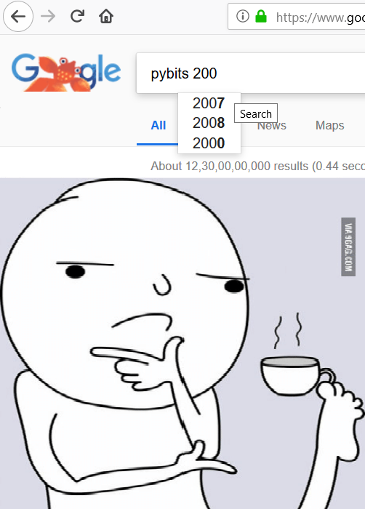


# Throwback On Timelines
Python
> Year? Date? Day?
> Anything significant
in 2018?
ATMOS
> Year?
> Date?
> Day?

Slide 3



# Lets Reiterate The Timelines!
That’s Caching ..

Slide 4


# What Of Caching
In my naive terms: Saved answer to question
Technically speaking: It is simply a local database/in-memory store where you can keep recently used objects and access them without going to the actual source.

Slide 5
# Why Of Caching
# performance improvements
# clone data which is expensive to look up
# too many requests or lookups slows down the primary objective of application
# without caching: trading storage space for time
# Phil Karlton says,
‘There are only two hard things in computer science: cache invalidation and naming things’

Slide 6
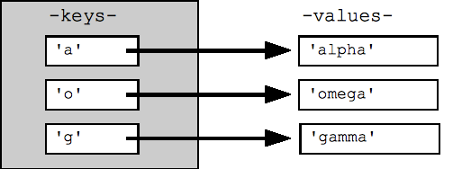
# Local Caching
--> Cache is local to only single instance of application
--> Data has to be identified for future use
--> dict() to the rescue {k --> v}
Looks simple ?

Slide 7
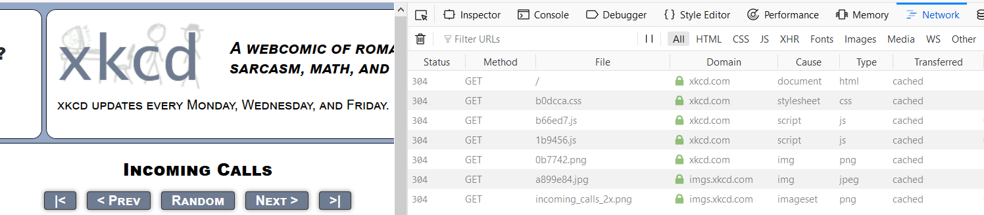
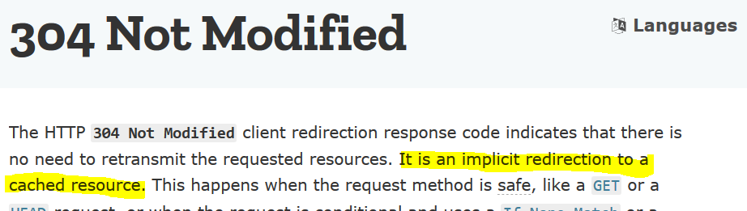
# REAL World Example
Status codes:
:404
:200
:304

Slide 8

# Some Advantages & Caveats
# Simple
# Fast
But,
>> size!
>> state!
>> expiration policy needed!

Slide 9
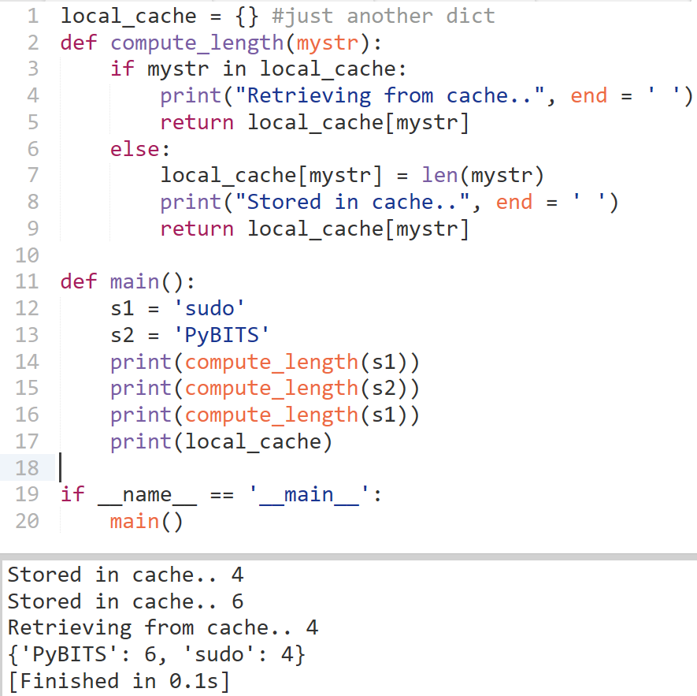
# Deep Dive
-> dict:hash tables
-> to perform lookup:
Indexing on #(keys)

Slide 10
# Grok The Dict!
goal of hash function: distribute keys evenly & minimize the number of collisions
Pseudo code of hash function for strings:
arguments: string object returns: hash function string_hash: if hash cached: return it set len to string's length initialize var p pointing to 1st char of string object set x to value pointed by p left shifted by 7 bits while len >= 0: set var x to (1000003 * x) xor value pointed by p increment pointer p set x to x xor length of string object cache x as the hash so we don't need to calculate it again return x as the hash

Slide 11
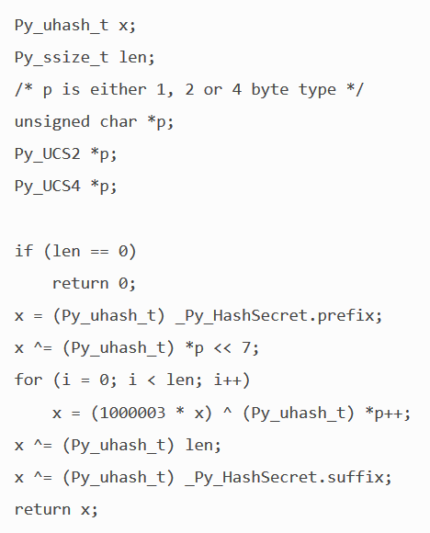
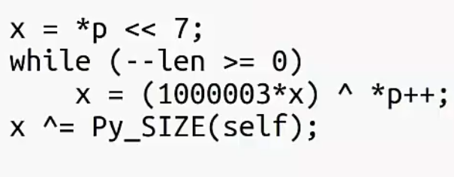
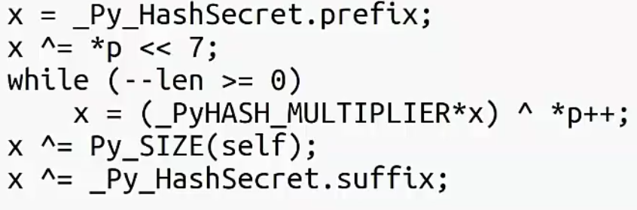
# Grok The Dict! {Lazy Hash()}
_{Python 3.2 and <}
_{Python 3.2.3 and >}
_{Python 3.4 and >}

Slide 12
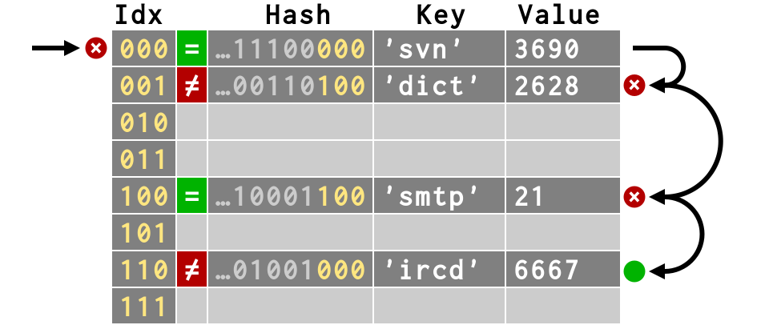
GRok The Dict!
Rules:
> Keys are hashed to produce indexes
> If at first you don’t succeed, try try again!

Slide 13
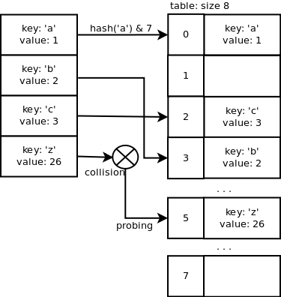
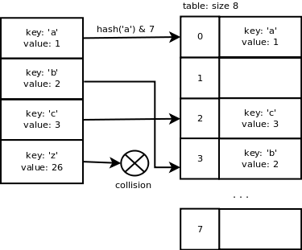
# Grok The Dict!
Collision Resolution ?

Slide 14
# Grok The Dict!
#returns new dictionary object function PyDict_New: allocate new dictionary object clear dictionary's table set dictionary's used slots + dummy slots (ma_fill) to 0 set dictionary's active slots (ma_used) to 0 set dictionary's mask (ma_value) to dictionary size - 1 set dictionary's lookup function to lookdict_string return allocated dictionary object --------------------------------------------
function PyDict_SetItem: if key's hash cached: use hash Else: calculate hash call insertdict with dictionary object, key, hash and value if key/value pair added successfully and capacity over 2/3: call dictresize to resize dictionary's table
#dict object in cpython
typedef struct { Py_ssize_t me_hash; PyObject *me_key; PyObject *me_value; } PyDictEntry;
typedef struct _dictobject PyDictObject; struct _dictobject { PyObject_HEAD Py_ssize_t ma_fill; Py_ssize_t ma_used; Py_ssize_t ma_mask; PyDictEntry *ma_table; PyDictEntry *(*ma_lookup)(PyDictObject *mp, PyObject *key, long hash); PyDictEntry ma_smalltable[PyDict_MINSIZE]; };

Slide 15
# Local Caching Using CacheTools
>> Why? To overcome the caveats with dict + leverage certain algorithms
>> What? Classes for implementing caches using different caching algorithms. Basically its ~ to api
>> Cachetools → Cache → collections.MutableMapping
>> LRU, LFU, RR, TTL

Slide 16
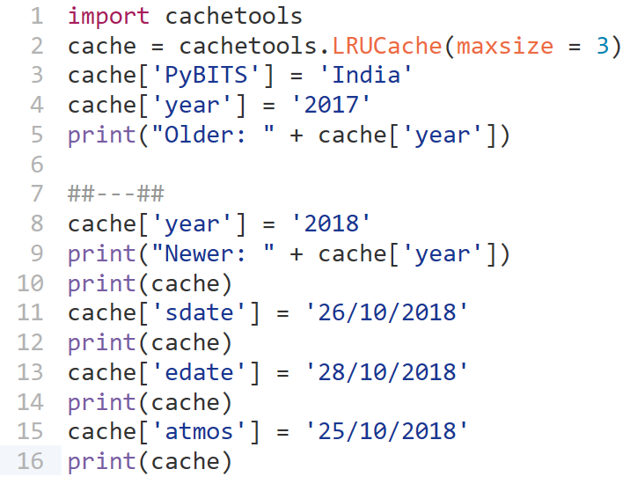
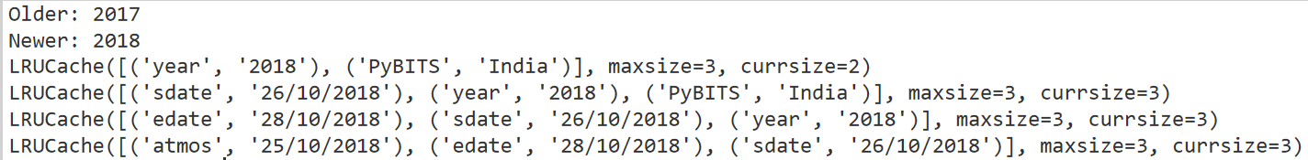
# Deep Dive

Slide 17
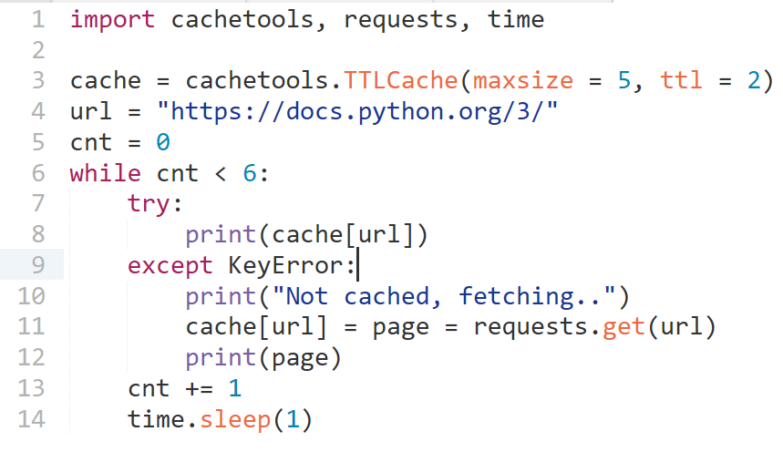
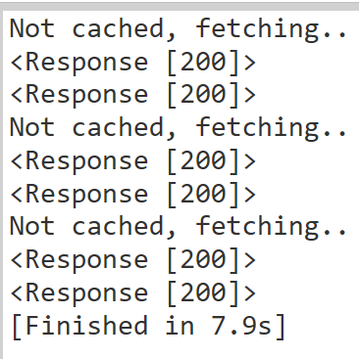
# Deep Dive - II

Slide 18
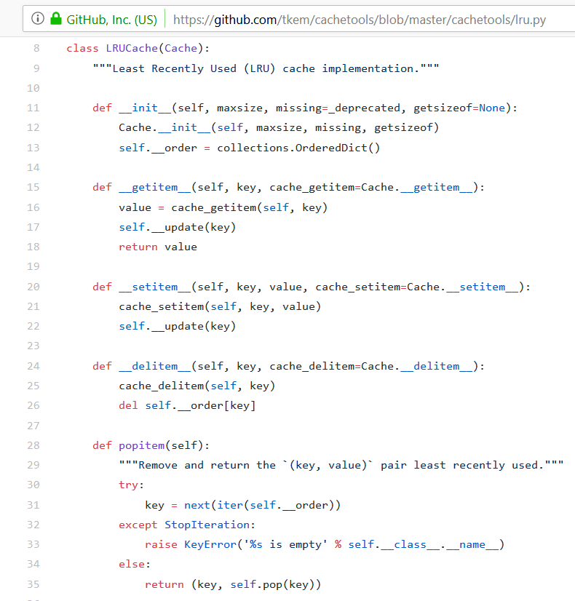
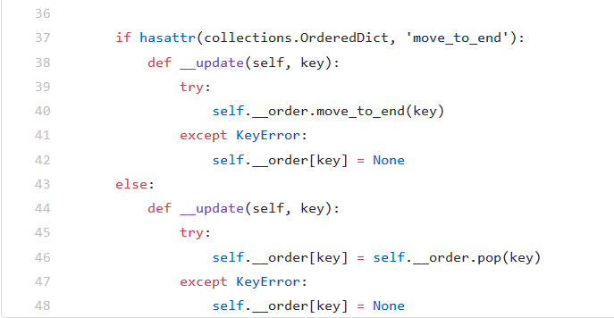
# CacheTools.lrucache() Under The Hood

Slide 19
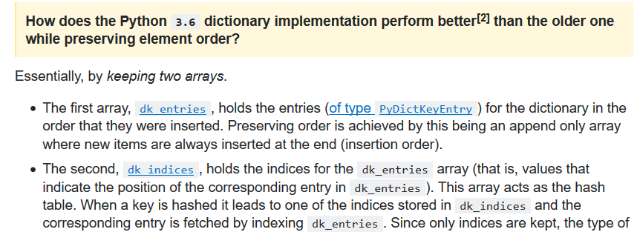
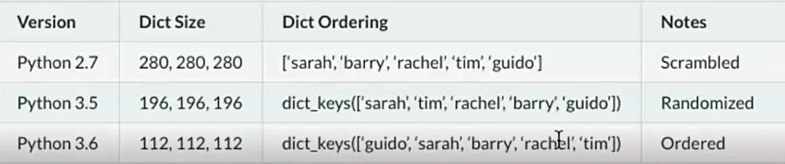
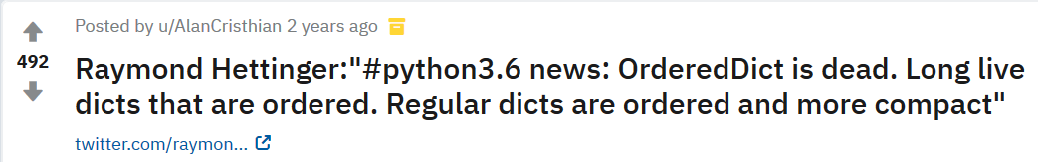
# Why collections.ordereddict

Slide 20
# Memoization
>> Keeping a “memo” of intermediate results to avoid repeated computations.
>> Way of caching results of function calls
>> Associate I with O and place it somewhere; assuming that for given I, O always remains the same.
>> Lower functions time cost in exchange of space cost

Slide 21
# Why Of Memoization
! Expensive code (~ to caching)
Computationally intensive code
Resources become dedicated to the expensive code
Repeated execution
! Recursive code
Common subproblems solved repeatedly
Top Down approach

Slide 22
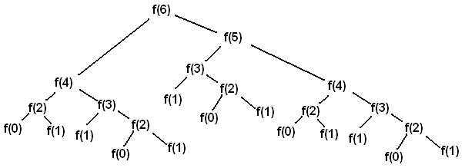
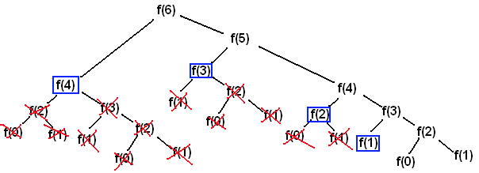
# Deep Dive
% Pseudocode:
Set up a cache data structure for function results
Every time the function is called, do one of the following:
Return the cached result, if any; or
Call the function to compute the missing result, and then update the cache before returning the result to the caller

Slide 23
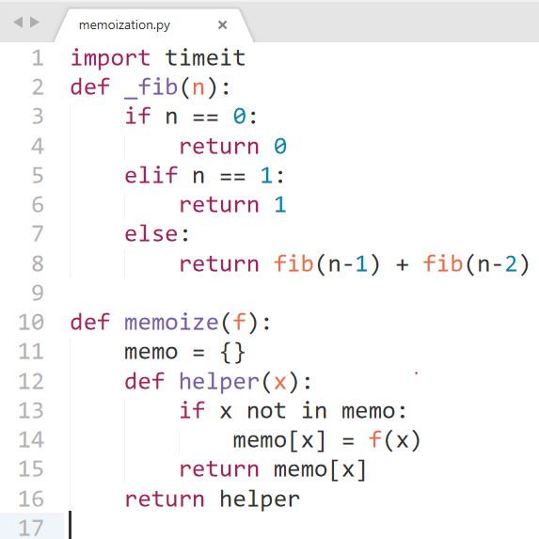
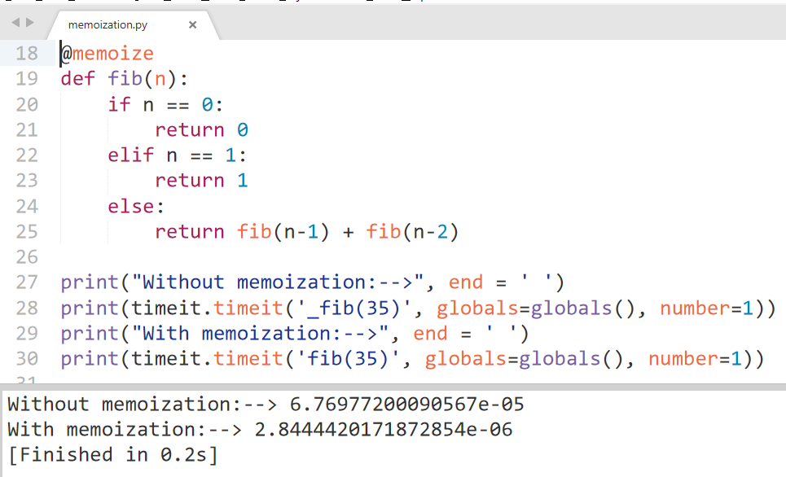
# Deep Dive - ii

Slide 24
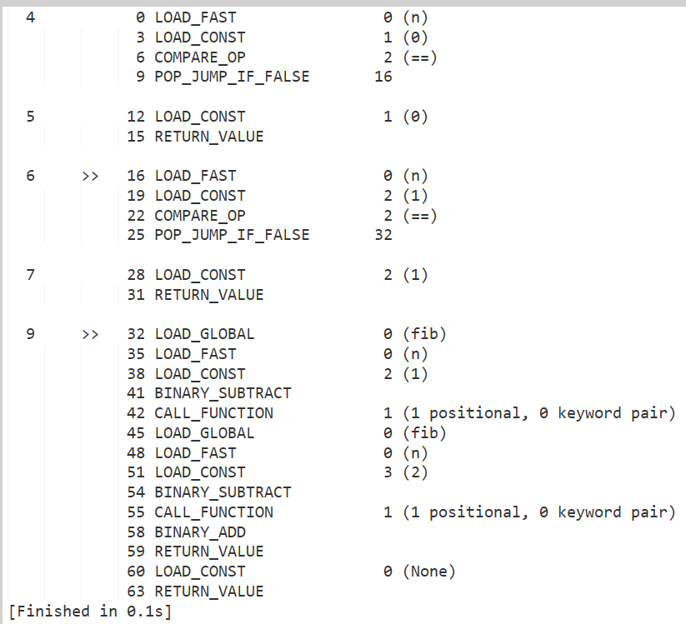
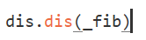

# Deep Dive 3a:
Hack With Dis

Slide 25
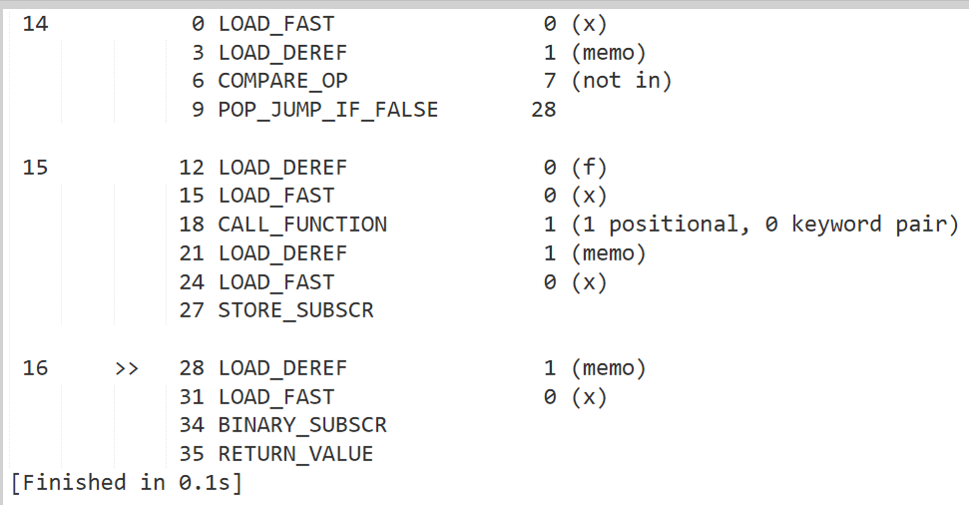
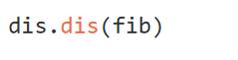

# Deep Dive 3b: Hack With Dis
Notes:
LOAD_FAST: reference from co_varnames pushed onto stack
LOAD_DEREF: Pushes a reference to the object the cell contains on the stack
COMPARE_OP: Performs a Boolean operation.
POP_JUMP_IF_FALSE: IF TOS is false, pop it

Slide 26
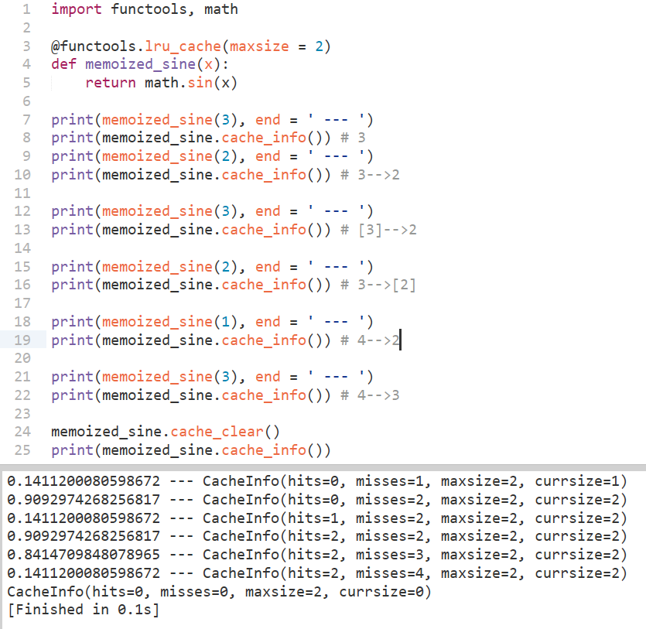
# Using FuncTools
> After 3.2
> No parameters required

Slide 27

# Distributed Caching
--> shared cache
--> memcached, redis

Slide 28

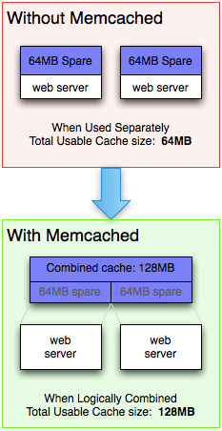
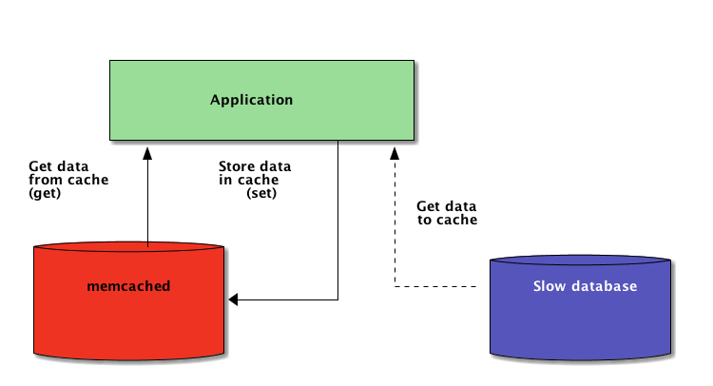
# Memcached
>> Takes memory from parts of your system where you have more than you need and make it accessible to areas where you have less than you need.
>> network-available dictionary

Slide 29
# Few Pointers To Consider
1. {k -> v} in memcache have their TTL. Hence, view the cache data as ephemeral.
2. Applications must handle cache invalidation
3. Warming a cold cache
4. Being ‘shared+remote’ causes concurrency issues
5. Memcached doesn’t return all the keys. Its a cache not a DB.
6. Internally memcached uses LRU Cache

Slide 30
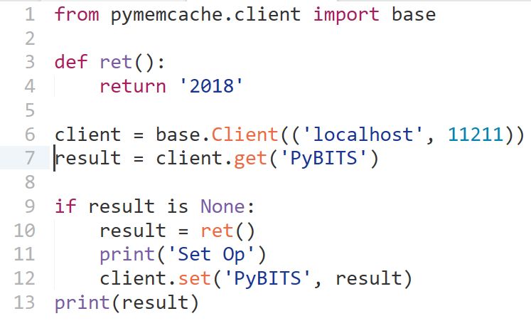
# Deep Dive - I

Slide 31
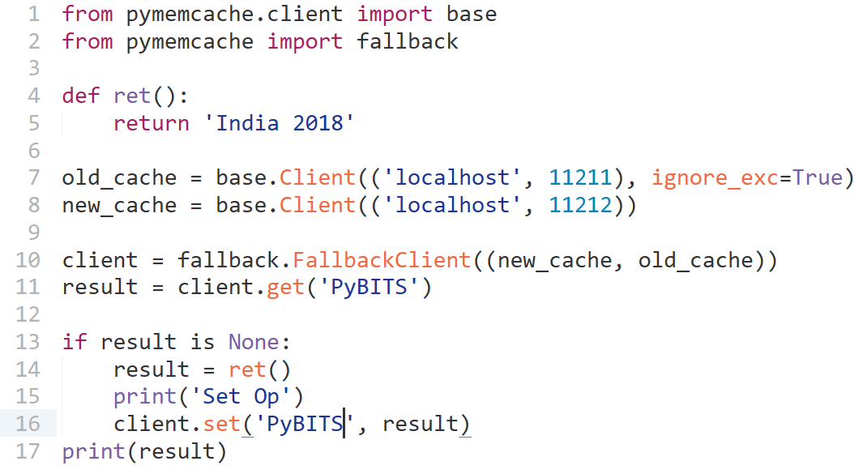
# Deep Dive - ii

Slide 32

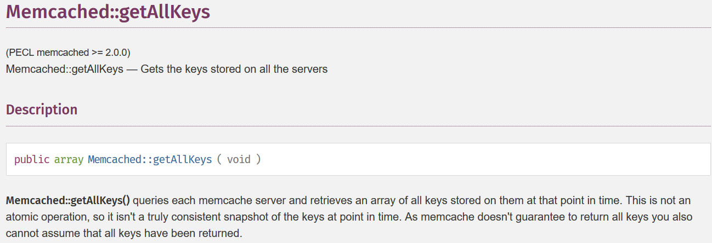
# Deep Dive - iii
In the general case, there is no way to list all the keys that a memcached instance is storing.
Ironically...

Slide 33

# Personal Advice - DMPF
Do More Progress Fast
Documentation
Mailing List
PEP’s
Follow
Blogs
Core Dev’s
From,

Slide 34
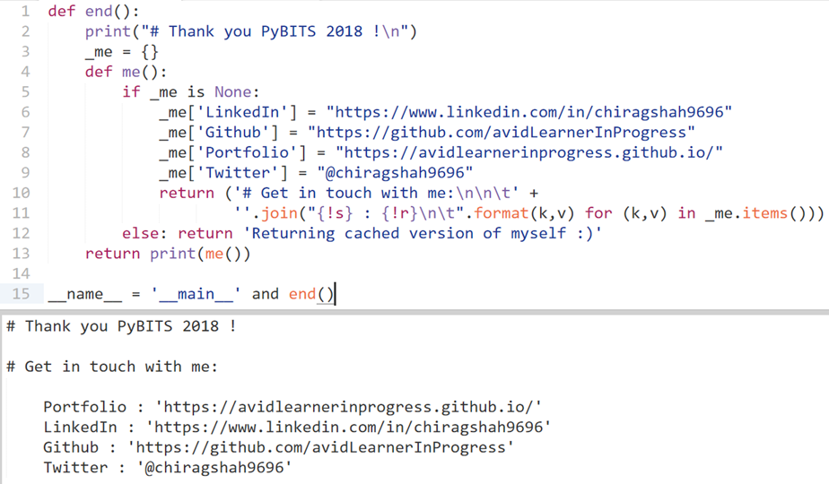
Ending with
canonical cache :)

